Slide 1

IRM
IRM Pricing Strategy
Team Members: Yukun Gao, Xinyan Cai, Yubo Feng, Zihui Xie
2020.02.02

Slide 2

CONTENTS
1
Data Scanning
2
Pricing Strategy
3
Potential Impact

Slide 3

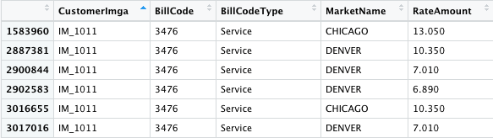
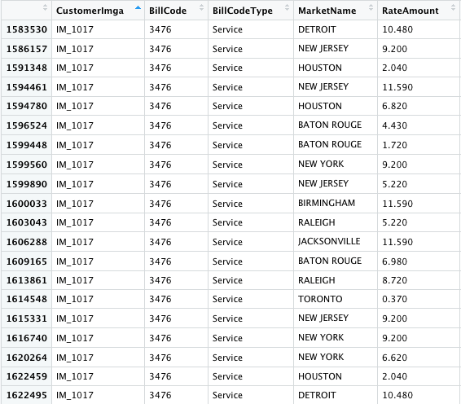
What do you see in the data?
To avoid the time variances of contaminating the data, we choose the most relevant year of 2019 to do our analysis.
01 paying by differences of location
Are there variances in customers‘ paying?
Same Customer IMGA & Same BillCode
Different locations having highly different prices.
It’s true that consumers are paying different by different locations.

Slide 4
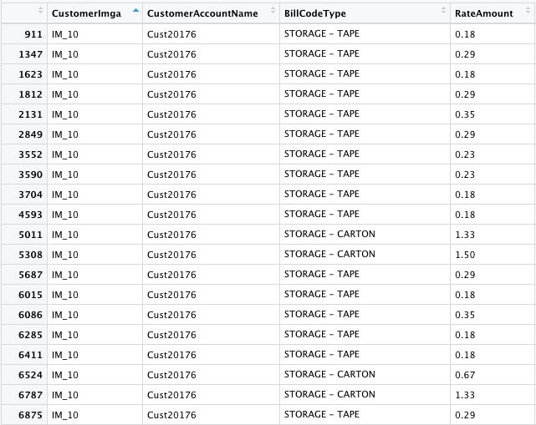
What do you see in the data?
02 paying by size of account numbers
Are there variances in customers‘ paying?
Same Customer IMGA& Same BillCodeType
Having multiple size of accounts, we can see customers are paying slightly different prices.

Slide 5
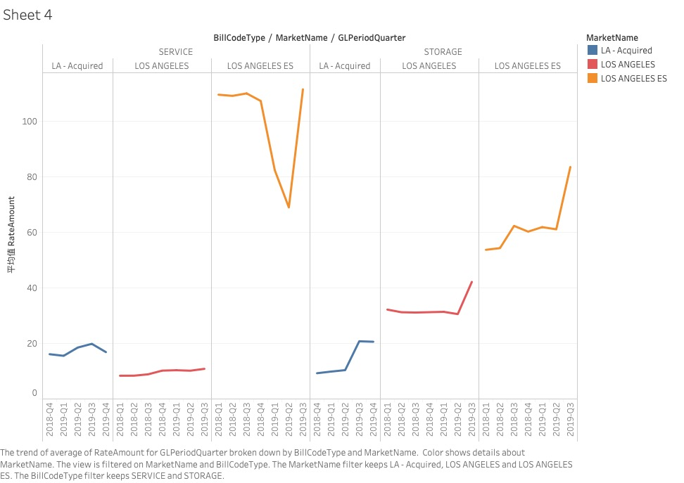
Logic explanation and visualization
To make the comparison between price of IRM and the Acquired, we need to control for other factors to make sure prices are comparable.
Here, the factors we want to control are
“Billcode Type” ,“Market name” and “time”.
By exploring the data on “LA-Acquired” we found it only contains two Billcode Types which are “service” and “storage”
Time periods from “2018-Q4” to “2019-Q4”
Location: “Los Angeles”
So we extracted the data where Market name contains Los Angeles and compared the average price for both service and storage type from
2018-Q4 to 2019-Q4.

Slide 6
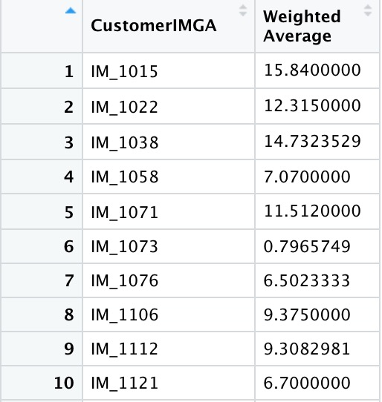
Determing CustomerIMGA Price of LA-acquired after acquisition
Example:
For finding a good reference of LA-acquired companies, we choose the same location of LA.
High
Then for every CustomerIMGA, we compute the weighted mean price by storage quantity.
Having the data, we divide the customers into two categories:
Lowest
Type I : For the CustomerIMGA having most(or all) percentage of service and transport bill code types:
They have the higher Weighted MeanPrice(at around 10)
Type II : For the CustomerIMGA having most(or all) percentage of storage bill code type:
They have the lower weighted Mean price(at around 0.8)
Recommendation:
For those CustomerIMGA of LA-acquired who belongs to Type I, we set the price 10.
For those CustomerIMGA of LA-acquired who belongs to Type II, we set the price 0.8.

Slide 7
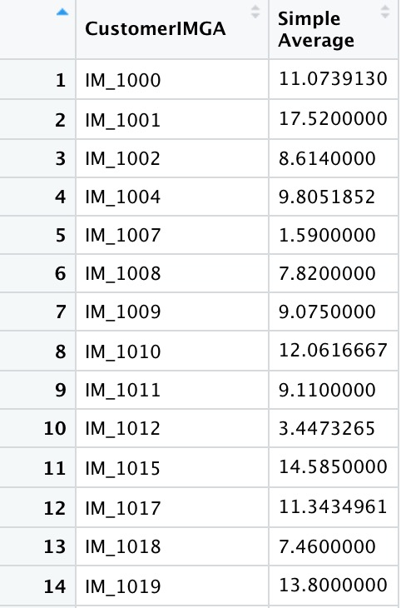
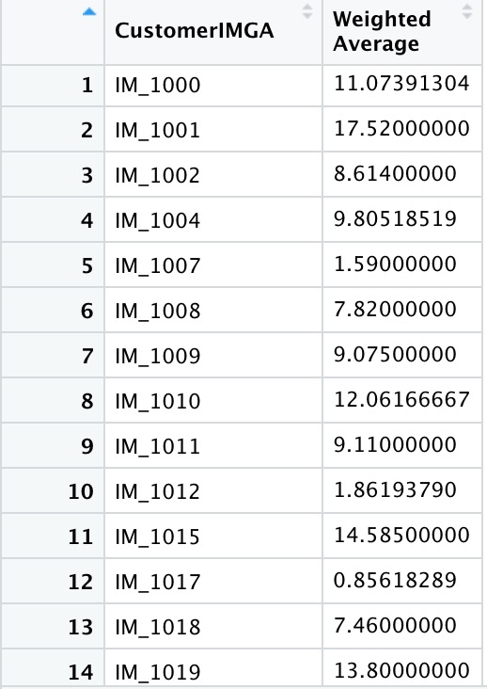
Determining a consolidated price for CustomerIMGA in the rest of the market
(except LA-acquired)
We used 2 types of approaches.
TypeI : weighted mean price by storage quantity for every CustomerIMGA
TypeII : simple mean price for every CustomerIMGA
We discovered that the difference of simple mean and weighted mean are mainly because of the proportion of storage
Bill code types, the specific example is given as follows.
For CustomerIMGA IM_1017 which
has a large proportion of storage bill
code type, the simple mean is high
and the weighted mean is low.

Slide 8



Determining a consolidated price for CustomerIMGA in the rest of Market (except LA-acquired) ---cont.
As discussed in last PPT, we could give a brief recommendation.
Scenario 1:For CustomerIMGA with high proportion of storage Bill code types, setting simple mean price is better.
Scenario 2:For CustomerIMGA with low proportion of storage Bill code types, both prices will work.
However, from the quantity and price relationship in business version, within scenario 1, the simple mean price is much higher than weighted one. Therefore we also need to consider the elasticity to determine whether we can set such a high price otherwise we will suffer substantial demand reduction.
For IM_1017, the elasticity is less than 1 which is inelastic. Therefore, we can set simple average at 11.3435.
Recommendation
For CustomerIMGA with low proportion of storage Bill code types , setting price either the simple mean prices or weighted mean price.
For CustomerIMGA with high proportion of storage Bill code types, we could use simple mean price if the demand is inelastic, otherwise we need to make a balance of weighted mean and simple mean to obtain higher revenue.

Slide 9
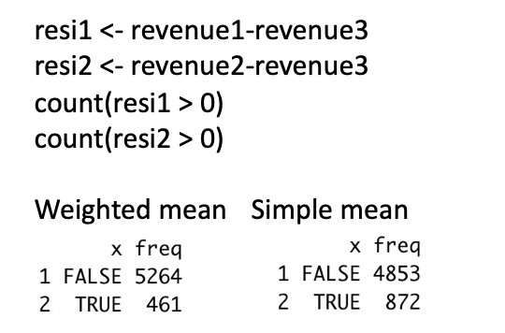
Remaining different prices for different locations might be better
for the rest of Market (except LA-acquired)
we used either weighted mean or simple mean to calculate every CustomerIMGA’s revenue and compared it with the previous total revenue for each CustomerIMGA.
We calculated the difference of these 2 revenues and counted the number of positive value and negative value.
Note: positive value means the revenue generated by weighted mean or simple mean is higher than the previous revenue.
Recommendation:
It might be better to remain setting different price. Since it follows the logic of price discrimination.
And for Richer markets, we could set higher price with same bill code types.
A consolidated price might not be a good choice.
As the True value (positive value) is much smaller compared to the false value.

Slide 10
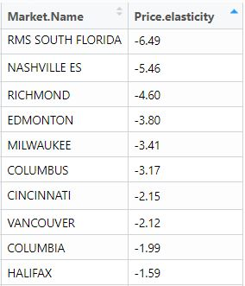

Potential Impact of Recommendations
01
02
Potential increase
in acquired location sales
Variation by Locations
As we recommend keeping setting distinctive prices by location as we did before, we will still need to consider the demand variation by locations.
Limited price increase should be considered in elastic markets.
Table on the right shows the top 10 elastic markets.
Given our recommendation, we intend to increase the prices offer to LA-acquired market to match our higher quality of service.
Since customers in this field are relatively insensitive to price change, and potentially have better rate of retention on higher service quality, we assume that the quantities of demand tends to remain non-fluctuated.
That will lead to an increase in sales.
The average price elasticity of LA-acquired market is less than 1, indicating an inelastic market reaction.

